Slide 1

Assignment
II
Luke Profio

Slide 2
Query 1 – Insurance Distribution Among ICU Admissions
Provides an overview of ICU admissions by insurance type.
Uses GROUP BY on the insurance field to count admissions per insurer. This includes a subquery which computes the percentage of total admissions for each insurance category.
Roughly half of ICU patients are covered by Medicare, followed by private insurance. Medicare and private insurance cover almost 90% of ICU patients.

Slide 3
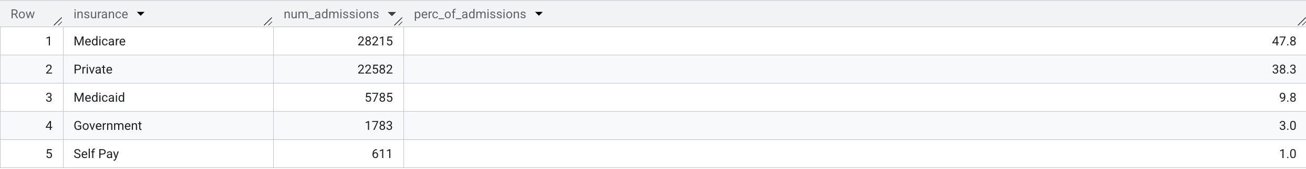
Query 1 - Results

Slide 4
Query 1
SELECT insurance, COUNT(*) AS num_admissions,
ROUND(COUNT(*) * 100.0 / (SELECT COUNT(*) FROM `physionet-data.mimiciii_clinical.admissions`), 1) AS perc_of_admissions
FROM `physionet-data.mimiciii_clinical.admissions`
GROUP BY insurance
ORDER BY num_admissions DESC;

Slide 5
Query 2 – Admission Sources by Insurance Type
This query examines how patients with different insurances enter the hospital (e.g. emergency department, transfer), to see if the payer type correlates with the admission source.
The query groups admissions by both insurance and admission_location, along with the entries for each combination. Results are ordered to list the most common admission sources for each insurance category.
In all but private insurance, patients primarily enter the hospital through emergency room admissions.

Slide 6
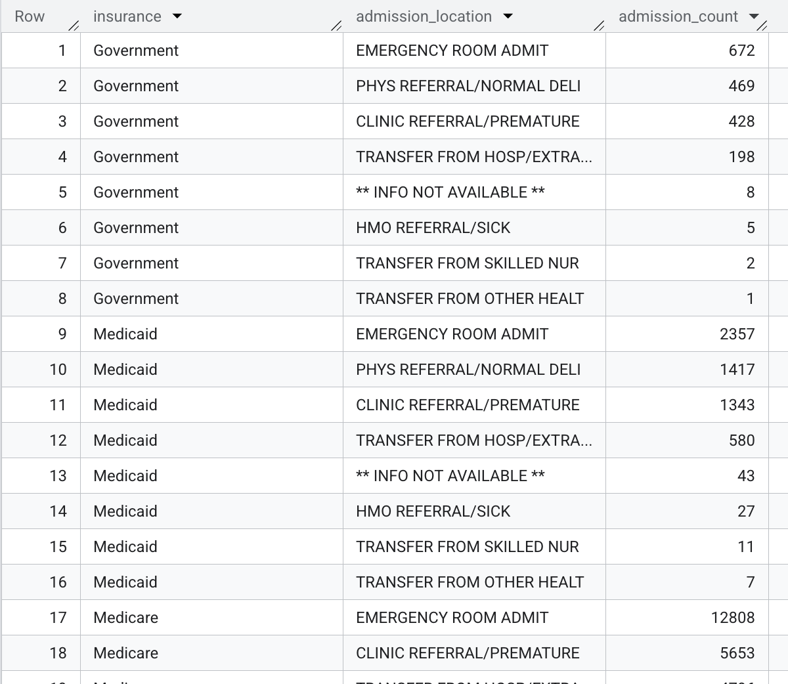
Query 2 – Results

Slide 7
Query 2 -
SELECT insurance, admission_location, COUNT(*) AS admission_count
FROM `physionet-data.mimiciii_clinical.admissions`
GROUP BY insurance, admission_location
ORDER BY insurance, admission_count DESC;

Slide 8
Query 3 – Discharge Disposition by Insurance Type
This query shows where patients go after their hospital/ICU stay, and how this varies by insurance type.
We use a GROUP BY on insurance and discharge_location to count the total number of discharges. Then we sort by count to highlight the most common discharge outcomes per insurance group.
Across all insurance types, patients are predominantly discharged to their home.

Slide 9
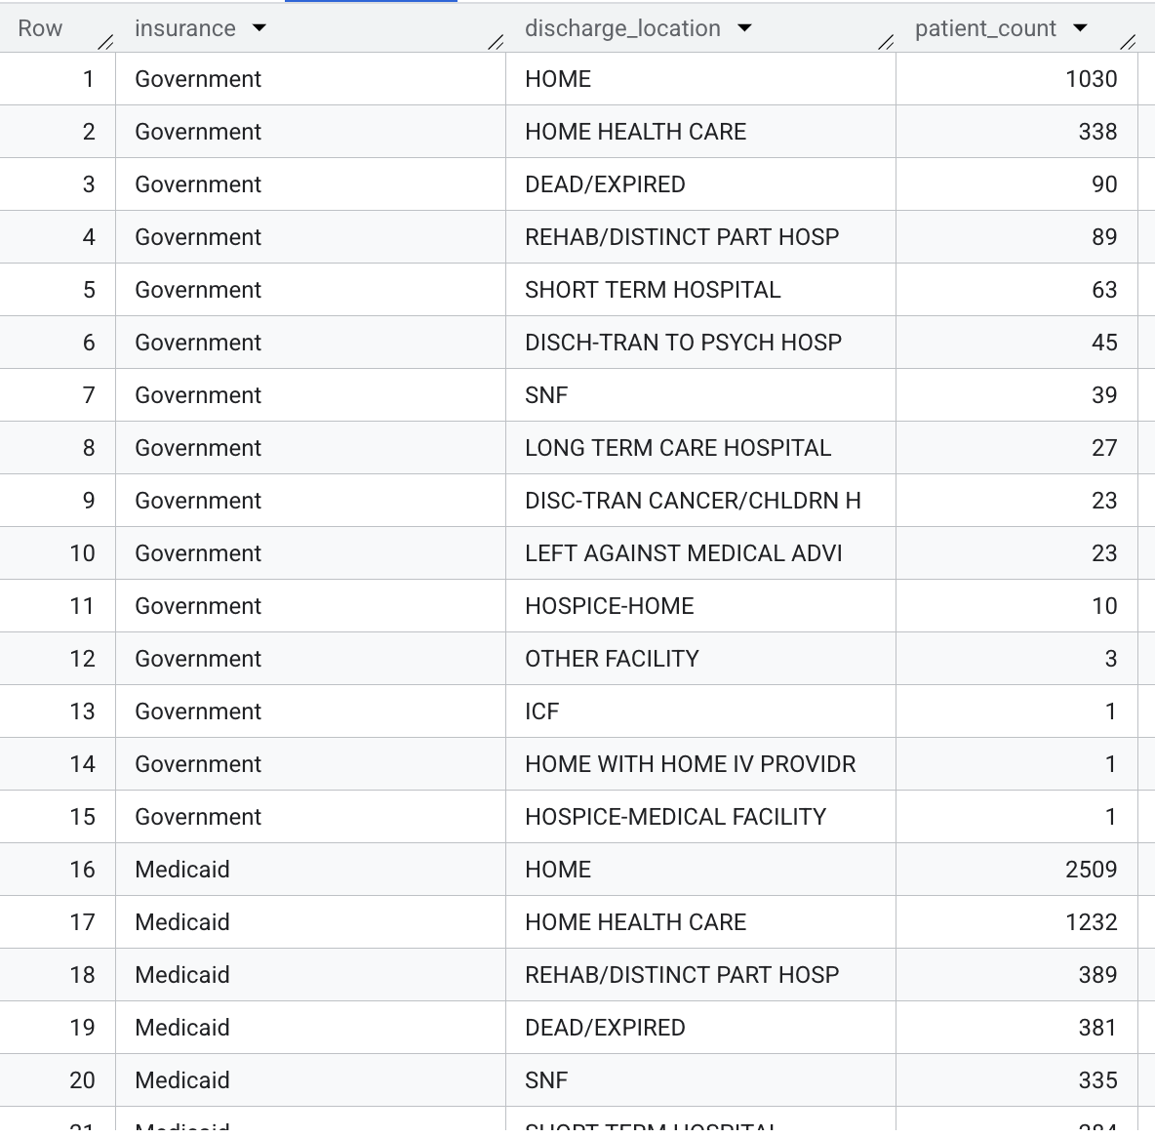
Query 3 – Results

Slide 10
Query 3 -
SELECT insurance, discharge_location, COUNT(*) AS patient_count
FROM `physionet-data.mimiciii_clinical.admissions`
GROUP BY insurance, discharge_location
ORDER BY insurance, patient_count DESC;

Slide 11
Query 4 – ICU Transfers by Insurance Type
Here we measure ICU utilization intensity by insurance type, especially to find how often patients had multiple ICU stays during a single hospital admission.
In the query we JOIN admissions with ICU stays on hospital admission ID, so each ICU stay is linked to the patient’s insurance. Then we use the COUNT and DISTINCT counts to calculate the average number of ICU stays per admission for each insurance category.
Medicare has the highest average number of ICU stays per admission, followed by Medicaid.

Slide 12
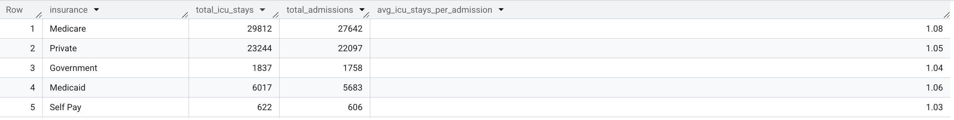
Query 4 – Results

Slide 13
Query 4 -
SELECT A.insurance,
COUNT(I.icustay_id) AS total_icu_stays,
COUNT(DISTINCT A.hadm_id) AS total_admissions,
ROUND(COUNT(I.icustay_id) * 1.0 / COUNT(DISTINCT A.hadm_id), 2) AS avg_icu_stays_per_admission
FROM `physionet-data.mimiciii_clinical.admissions` A
JOIN `physionet-data.mimiciii_clinical.icustays` I
ON A.hadm_id = I.hadm_id
GROUP BY A.insurance;

Slide 14
Query 5 – Average ICU Length of Stay by Insurance Type
This query compares the average ICU length of stay (LOS) for patients by insurance type.
A subquery first calculates each admission’s total ICU LOS by summing los across all ICU stays in that hospitalization . The outer query then groups by insurance and averages those totals. This makes sure multi-ICU stays are combined per admission before averaging.
Medicaid has the highest average ICU length of stay, followed by private insurance.

Slide 15
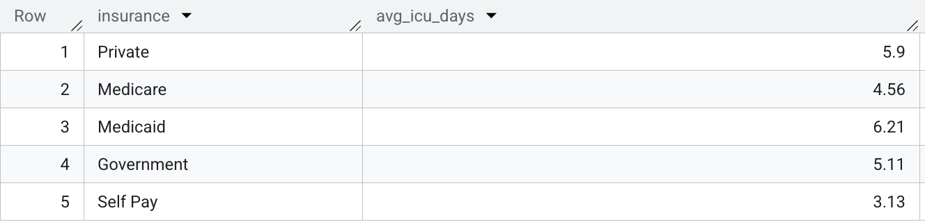
Query 5 – Results

Slide 16
Query 5 -
SELECT insurance, ROUND(AVG(total_icu_days), 2) AS avg_icu_days
FROM (
SELECT A.hadm_id, A.insurance, SUM(I.los) AS total_icu_days
FROM `physionet-data.mimiciii_clinical.admissions` A
JOIN `physionet-data.mimiciii_clinical.icustays` I
ON A.hadm_id = I.hadm_id
GROUP BY A.hadm_id, A.insurance
) AS per_adm
GROUP BY insurance;

Slide 17
Query 6 – Average Number of Procedures by Insurance Type
Here we evaluate how many procedures patients undergo on average per admission for each insurance category. This reveals the utilization intensity by payer group.
A subquery counts procedures for each hospital admission. We LEFT JOIN this to the admissions table to include admissions with zero procedures. Then we group by insurance and take the average count of procedures per admission.
Medicare has the highest average number of procedures, followed by private insurance.

Slide 18
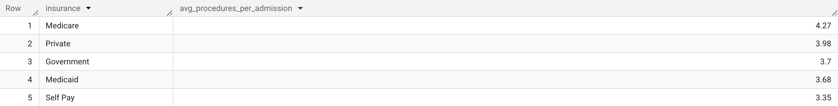
Query 6 – Results

Slide 19
Query 6 -
SELECT A.insurance,
ROUND(AVG(COALESCE(proc.num_procedures, 0)), 2) AS avg_procedures_per_admission
FROM `physionet-data.mimiciii_clinical.admissions` A
LEFT JOIN (
SELECT hadm_id, COUNT(*) AS num_procedures
FROM `physionet-data.mimiciii_clinical.procedures_icd`
GROUP BY hadm_id
) AS proc
ON A.hadm_id = proc.hadm_id
GROUP BY A.insurance;

Slide 20
Query 7 – Most Common Procedure for Each Insurance Category
Here we identify the most frequently performed procedure (by ICD-9 code) for each insurance group, showing the most common treatments/procedures for each patient segment.
We use a common table expression, proc_counts, to count occurrences of each procedure code per insurance. A second CTE max_proc finds the maximum count per insurance. The overall query joins these to show the procedure code(s) with the max count for each insurance.
Venous catheterization is the most common procedure for Medicare (highest count) and Medicaid.

Slide 21
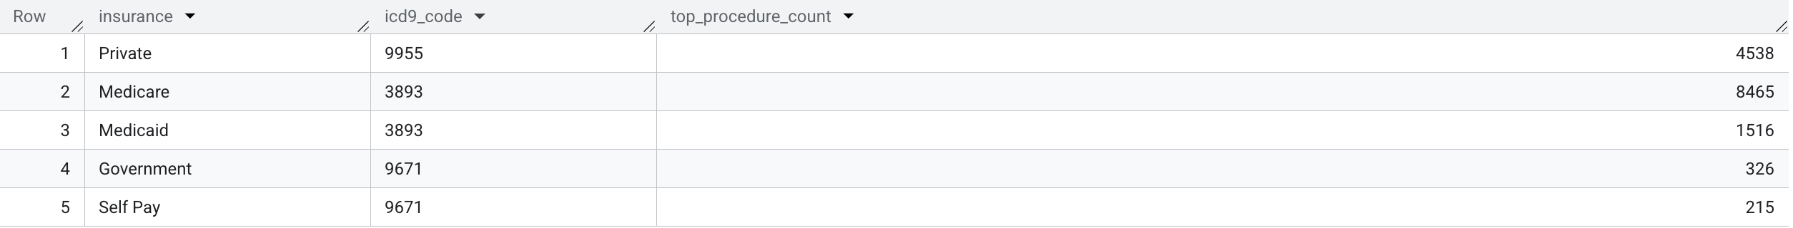
Query 7 – Results

Slide 22
Query 7 -
WITH proc_counts AS (
SELECT A.insurance, P.icd9_code, COUNT(*) AS proc_count
FROM `physionet-data.mimiciii_clinical.admissions` A
JOIN `physionet-data.mimiciii_clinical.procedures_icd` P
ON A.hadm_id = P.hadm_id
GROUP BY A.insurance, P.icd9_code
), max_proc AS (
SELECT insurance, MAX(proc_count) AS max_count
FROM proc_counts
GROUP BY insurance
)
SELECT pc.insurance, pc.icd9_code, pc.proc_count AS top_procedure_count
FROM proc_counts pc
JOIN max_proc mp
ON pc.insurance = mp.insurance AND pc.proc_count = mp.max_count;

Slide 23
Query 8 – Average Hospital Length of Stay by Insurance Type
Here we compare the average total hospital length of stay for patients by insurance type.
We calculate the duration in days between admission and discharge (TIMESTAMP_DIFF) for each record, then use GROUP BY insurance with an AVG to find the mean stay length for each insurance category.
Medicaid holds the highest average total hospital length of stay, followed by private insurance.

Slide 24
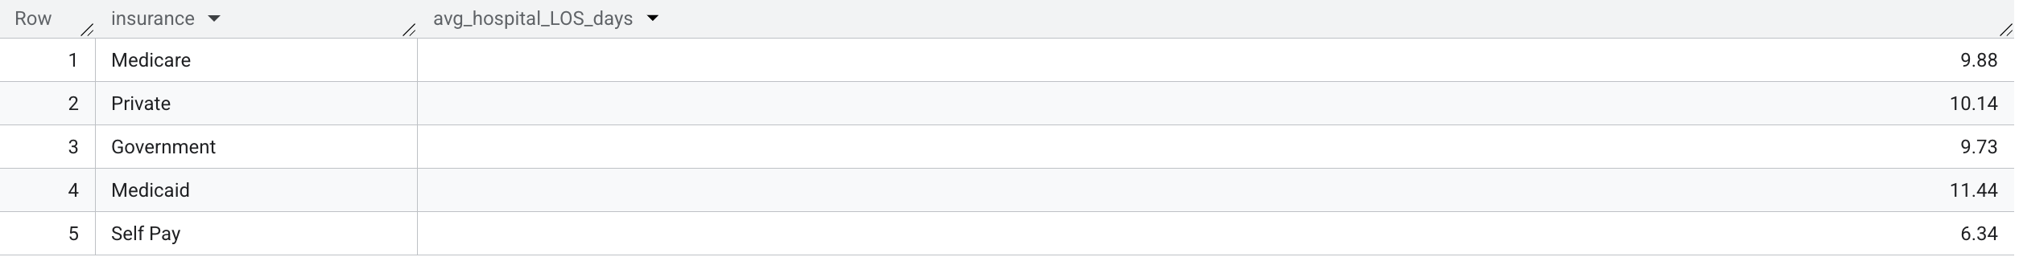
Query 8 – Results

Slide 25
Query 8 -
SELECT insurance,
ROUND(AVG(TIMESTAMP_DIFF(dischtime, admittime, DAY)), 2) AS avg_hospital_LOS_days
FROM `physionet-data.mimiciii_clinical.admissions`
GROUP BY insurance;

Slide 26
Query 9 – In-Hospital Mortality Rate by Insurance Type
Here we calculate the in-hospital mortality for each insurance group – the percentage of admissions where the patient died before discharge. This indicates if mortality varies with insurance.
We use the hospital_expire_flag in a SUM to count deaths per insurance, divided by total admissions per insurance. The GROUP BY shows mortality counts and computes a percentage.
Medicare and self-pay cohorts hold the highest in-hospital mortality rate.

Slide 27
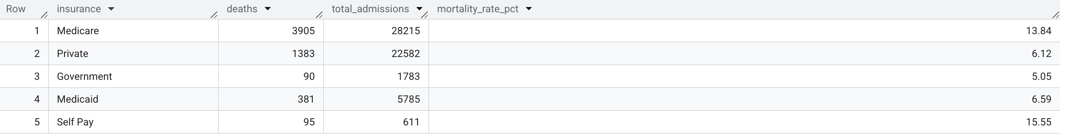
Query 9 – Results

Slide 28
Query 9 -
SELECT insurance,
SUM(CASE WHEN hospital_expire_flag = 1 THEN 1 ELSE 0 END) AS deaths,
COUNT(*) AS total_admissions,
ROUND(100 * SUM(CASE WHEN hospital_expire_flag = 1 THEN 1 ELSE 0 END) / COUNT(*), 2) AS mortality_rate_pct
FROM `physionet-data.mimiciii_clinical.admissions`
GROUP BY insurance;

Slide 29
Query 10 – 30-Day Readmission Rate by Insurance Type
Here we pull data from the admissions table to find the 30-day readmission rate by insurance type.
For each hospital stay, we use a nested EXISTS subquery to check if the same patient was readmitted within 30 days of their discharge. Then we count total admissions per insurance and how many of those had a qualifying readmission. Finally, we calculate the 30-day readmission percentage per insurance.
Medicare and Medicaid hold the highest 30-day readmission rates.

Slide 30
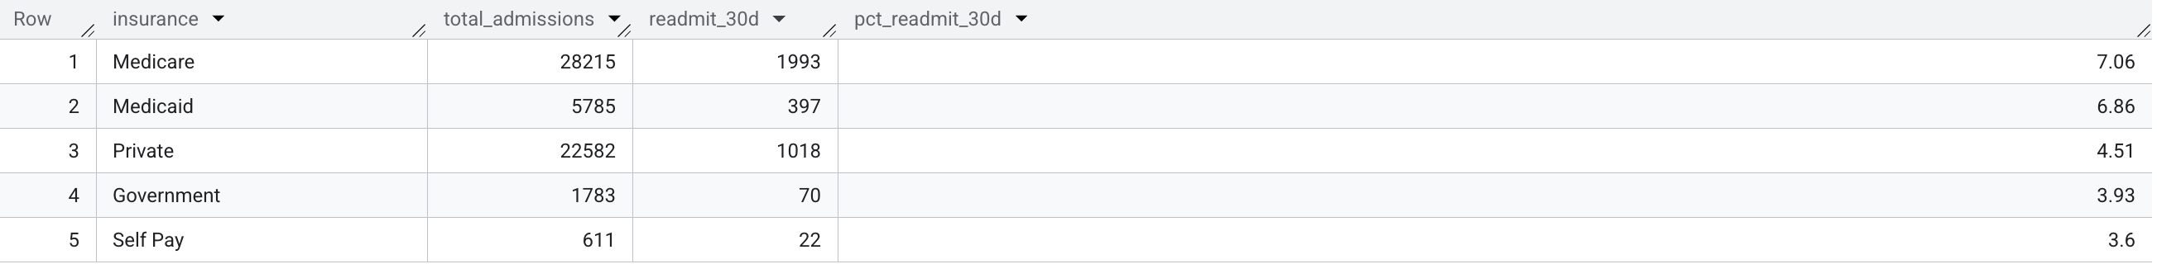
Query 10 – Results

Slide 31

Query 10 -

Slide 32
Broader Theme –
Medicare and private insurance cover roughly 90% of ICU admissions, and most patients arrive through the emergency department.
Medicare patients have the highest average number of ICU stays per admission, while Medicaid patients have the longest ICU length of stay.
Medicare and private-insured patients have the most procedures on average, and Medicaid patients have the longest overall hospital stays.
In-hospital mortality and 30-day readmission rates peak for Medicare and Medicaid, so there are payer-driven disparities in patient outcomes.

